Slide 1
ESG E MULTIMODAL TREATMENT. LE EVIDENZE SCIENTIFICHE
Matteo Monami
Diabetology and Metabolic Disease Unit
Careggi Teaching Hospital

Slide 2
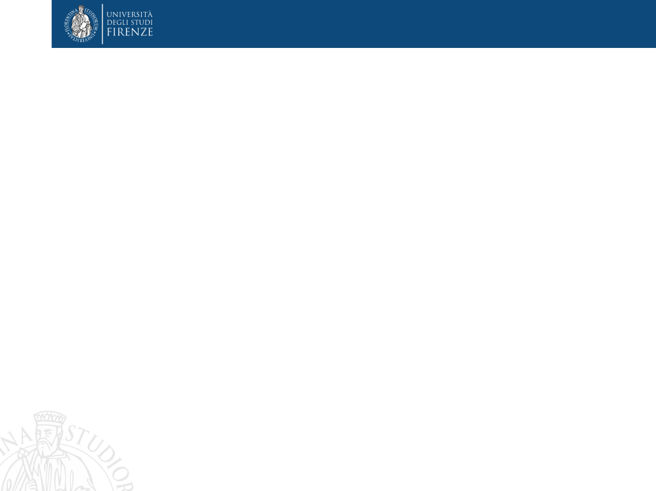
Il Dr. M. Monami ha ricevuto speaking fees/grant da:
Boehringer
Lilly
Novonordisk
Biocomposites
Molteni
e da Società Scientifiche:
SICOB
IFSO
EASO
SIO

Slide 3
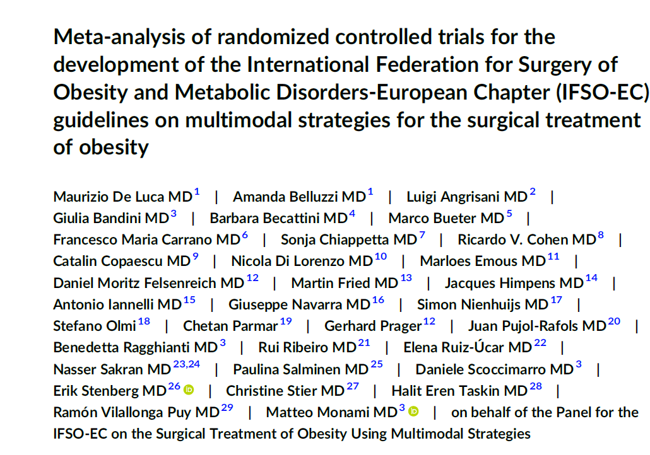
Briefly, the present analysis includes all RCTs enrolling patients affected by obesity undergoing different MBS procedures (AGB, SG, RYGB, OAGB, SADI-S, VBG, BPD, and GCP) in addition to other anti-obesity strategies (extensive lifestyle interventions—LSI, OMM, or EP), with a duration of at least 6 months. RCTs excluded were on either recurrent weight gain (WR) or insufficient weight loss (IWL) after MBS unless the use
of LSI or other obesity-management strategies was preplanned for all included patients (not only for those with suboptimal clinical response).
IFSO position statements

Slide 4
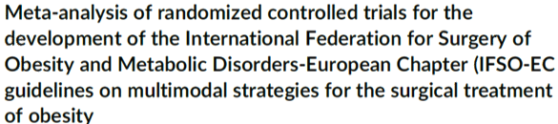
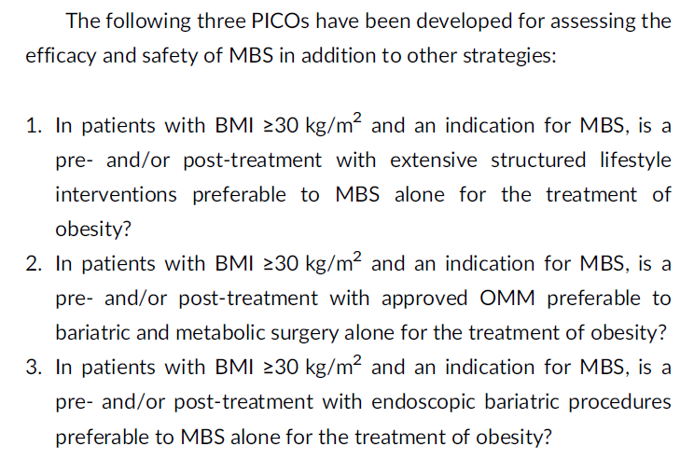

Slide 5
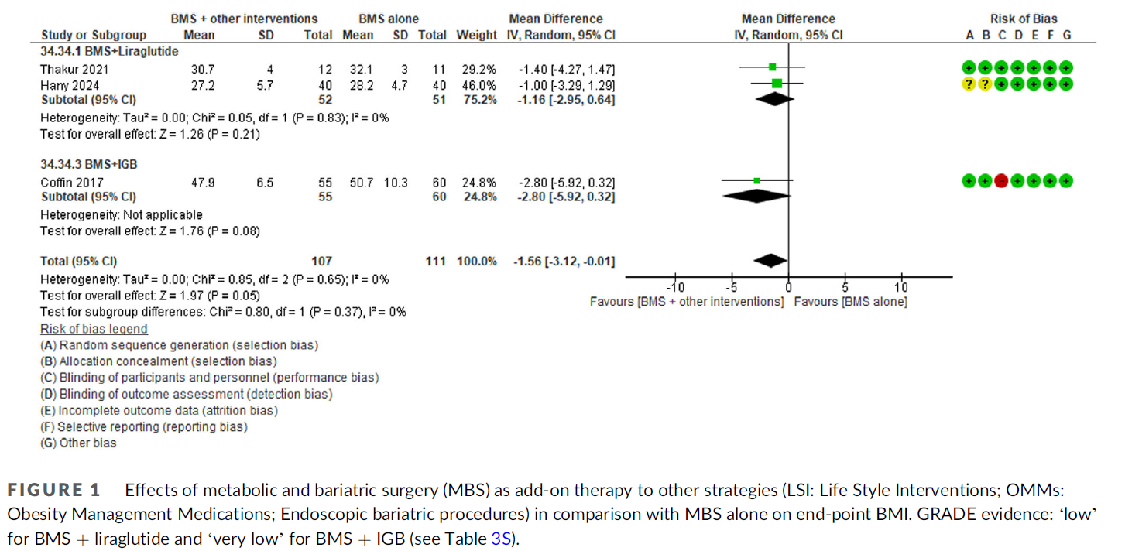
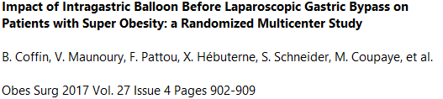
6-month FU after MBS
*
*From 6 weeks post-operative until 6 months

Slide 6
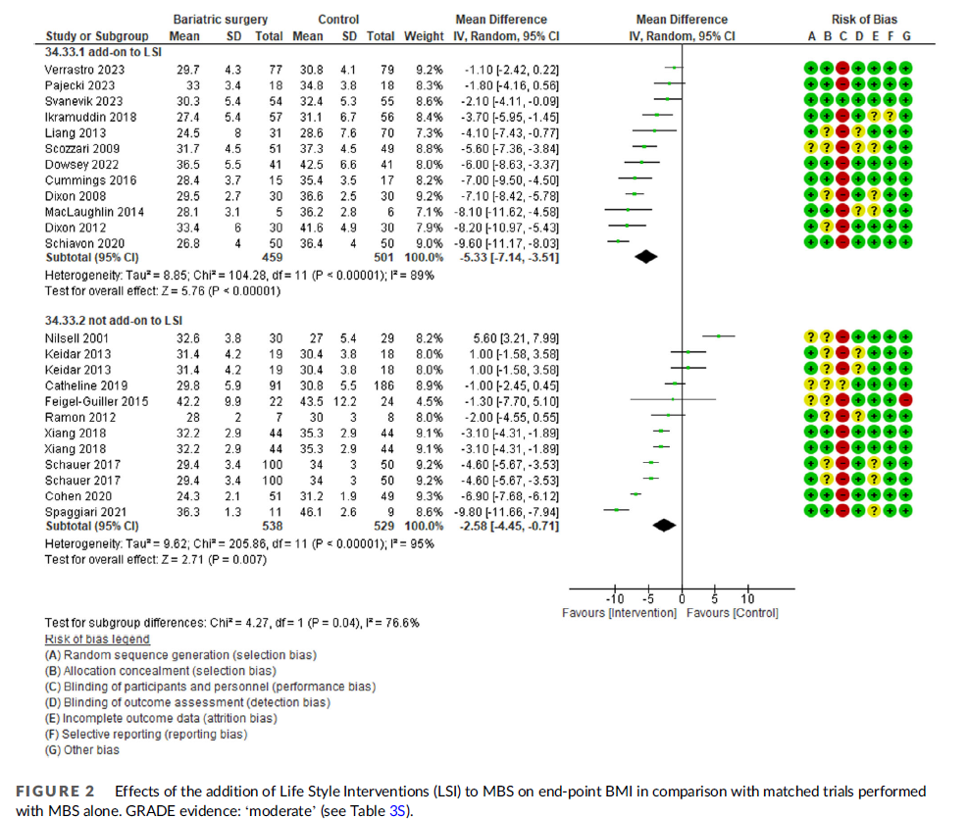
MBS+LSI vs LSI
MBS vs LSI

Slide 7
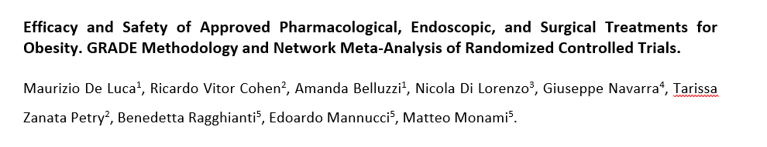
IFSO position statements
De Luca et al., manuscript submitted
Notes:
Per rendersi meglio conto dell’importanza dei farmaci, multimodal eccvi faccio vedere

Slide 8
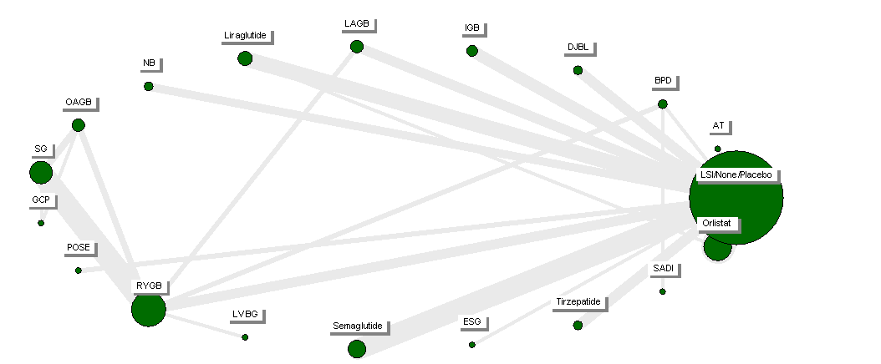
From 26 weeks to 10 years
N= 150 comparisons

Slide 9
From 26 weeks to 10 years
N= 150 comparisons
B. K. Abu Dayyeh, et al. Endoscopic sleeve gastroplasty for treatment of class 1 and 2 obesity (MERIT): a prospective, multicentre, randomised trial. Lancet 2022 Vol. 400 Issue 10350 Pages 441-451.
LSI+ESG vs LSI alone

Slide 10
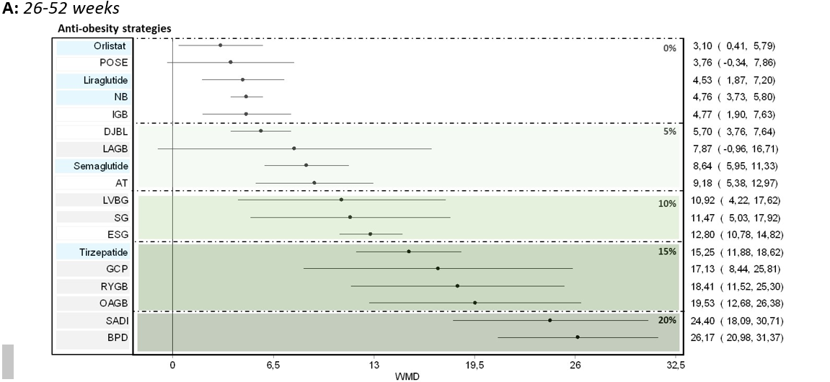
Total Body Weight Loss, %
LSI+ESG+…

Slide 11
Grazie

